Slide 1
Four Skinny Trees
By Sandra Cisneros
Notes:
‹#›

Slide 2
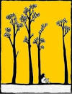
They are the only ones who understand me. I am the only one who understands them. Four skinny trees with skinny necks and pointy elbows like mine.
Notes:
‹#›

Slide 3
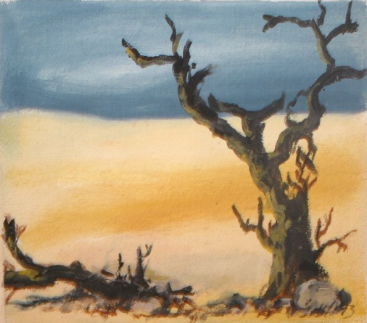
Four who do not
belong here but are
here. Four raggedy
excuses planted by
the city. From our
room we can hear
them, but Nenny
just sleeps and
doesn’t appreciate
these things.

Slide 4
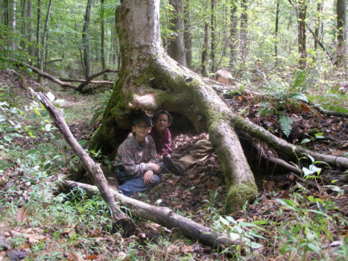
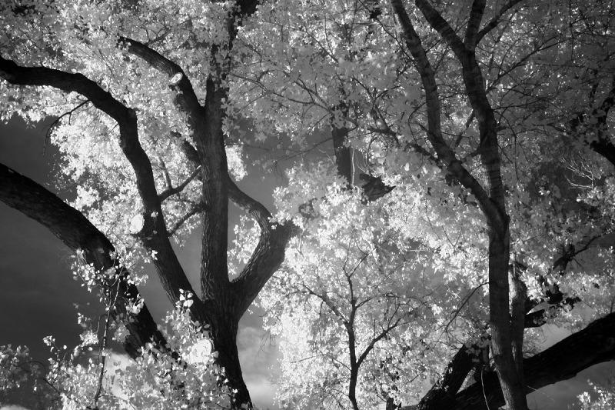
Their strength is secret. They send ferocious roots beneath the ground. They grow up and they grow down and grab the earth between their hairy toes and bite the sky with violent teeth ad never quit their anger. This is how they keep.
Notes:
‹#›

Slide 5
Let one forget his
reason for being,
they’d all droop like
tulips in a glass,
each with their
arms around each
other. Keep, keep,
keep, trees say
when I sleep.
They teach.
Notes:
‹#›

Slide 6
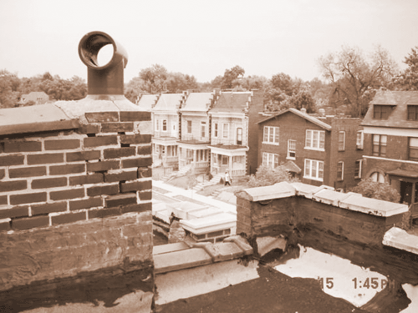
When I am too sad and too skinny to keep keeping, when I am a tiny thing, against so many bricks, then it is I look at trees. When there is nothing left to look at on this street. Four who grew despite concrete. Four who reach and do not forget to reach. Four whose only reason is to be and be.
Notes:
‹#›

Slide 7
What did you notice?

Slide 8
Some Poetic Devices
Personification-giving a non-human thing human qualities
Assonance-repetition of the same vowel sounds
Simile-comparison using like or as
Repetition-words repeated for impact
Symbolism-something represents something other than itself

Slide 9
Talk in your group. What did the trees represent to the author?
Where did the author use personification? Make a list of the things that were described with personification.
How did the author use personification to enhance your understanding of the poem’s theme?
Notes:
‹#›

Slide 10
Literary Terms
Term | Definition and Example | Non-linguistic representation
assonance | repetition of the same vowel sounds “keep , keep, keep, trees say when I sleep. They teach.”

Slide 11
Symbolism
What does the author use to symbolize something in the poem?
What does it symbolize?
How does this add to your understanding of the theme.

Slide 12
Sound effects
What words are repeated? Why does she do this?
Cisneros uses assonance, repetition of vowel sounds. Where does she do this?

Slide 13
LAPS
L--Write three quotes that use poetic devices | A-identify those poetic devices (like metaphor)
P-explain the poetic device--this shows that, this means that, this implies | S-What is Cisneros trying to tell the reader in the piece?

